Slide 1
Pizza Dashboard
1435234, 1437782, Tristan Buls, 1352346, 1432965

Slide 2
Table of content
Mockups
Mainpage
Storeview
Live demo

Slide 3
Mockups

Slide 4
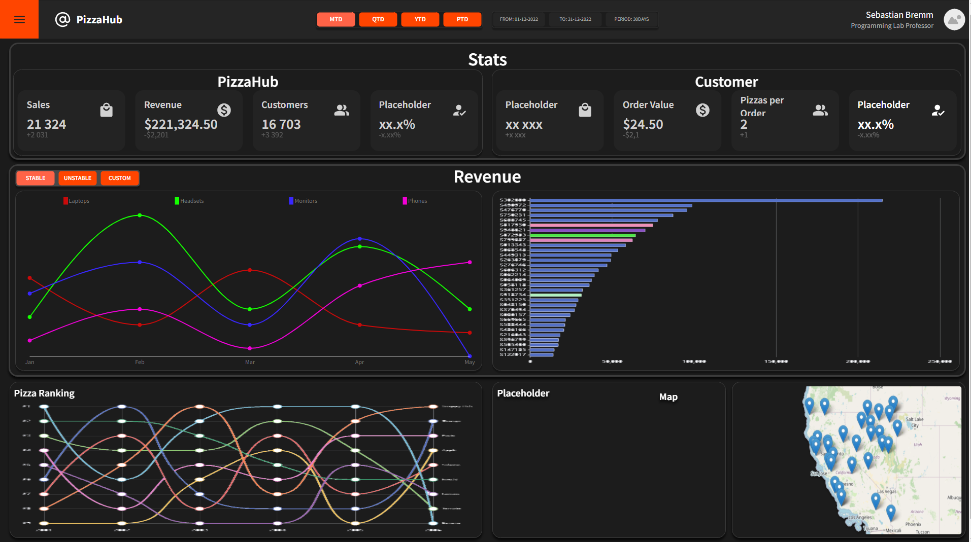

Slide 5
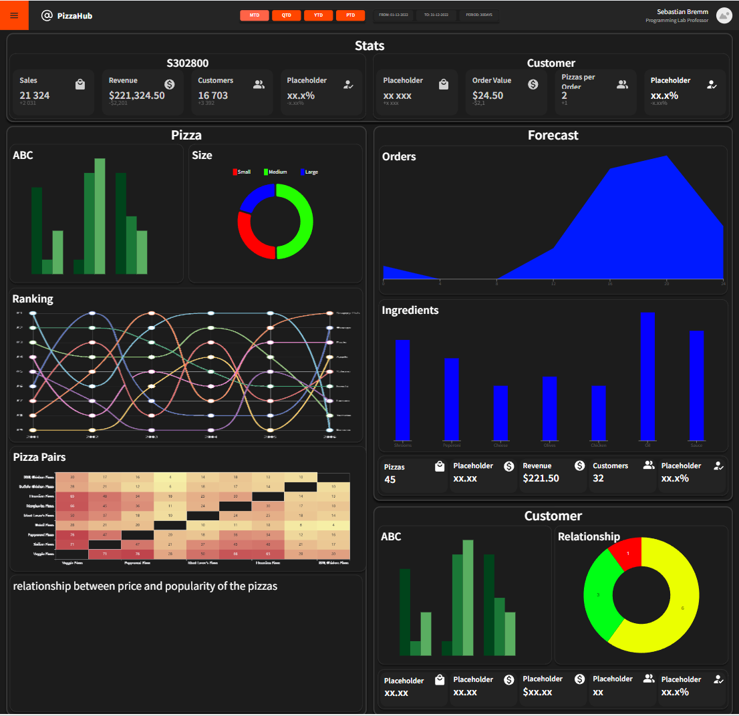

Slide 6
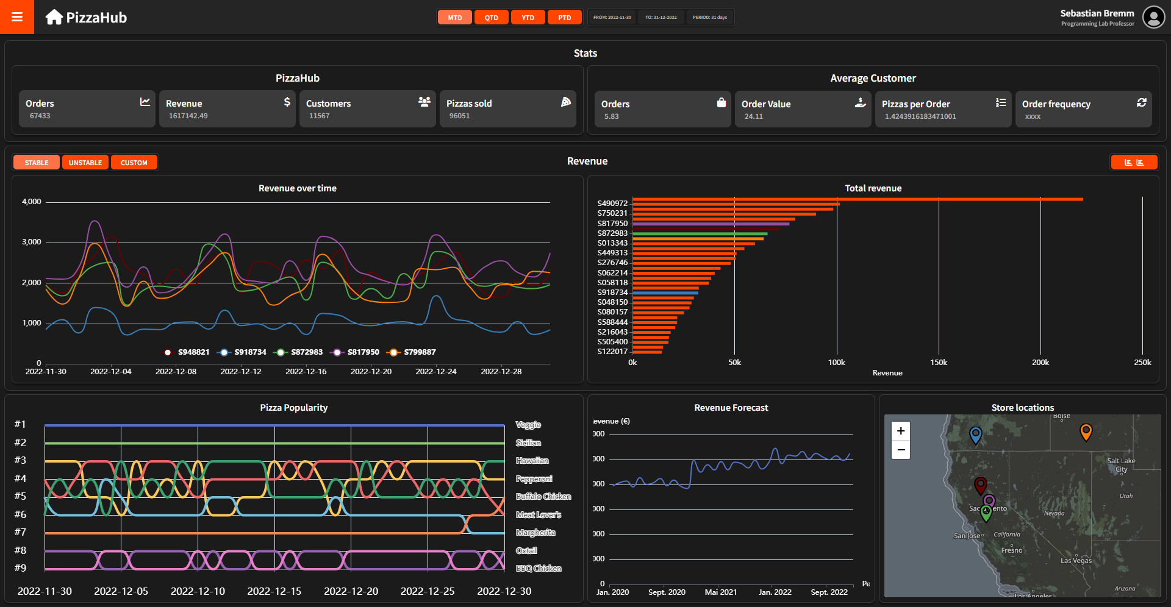
Mainpage

Slide 7
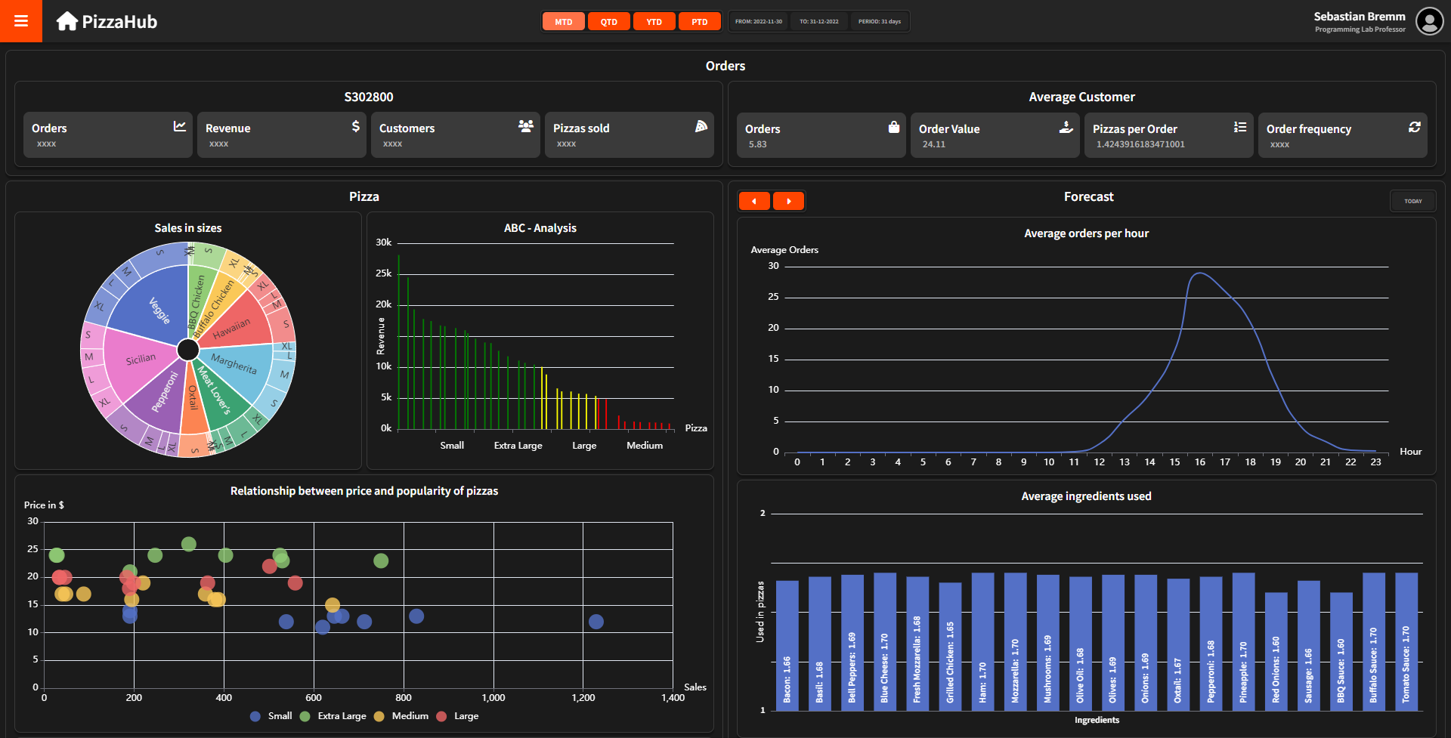
Storeview

Slide 8
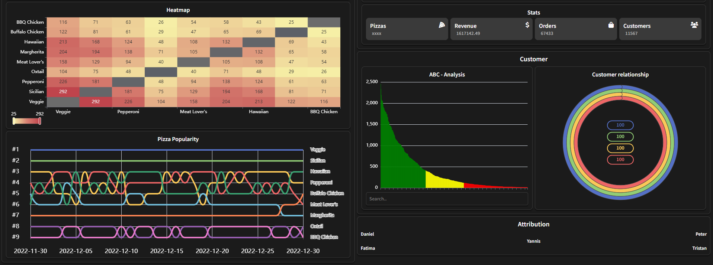

Slide 9
Live demo

